Slide 1
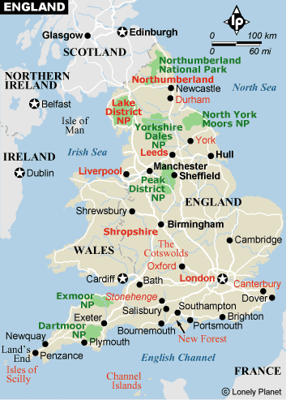

Slide 2
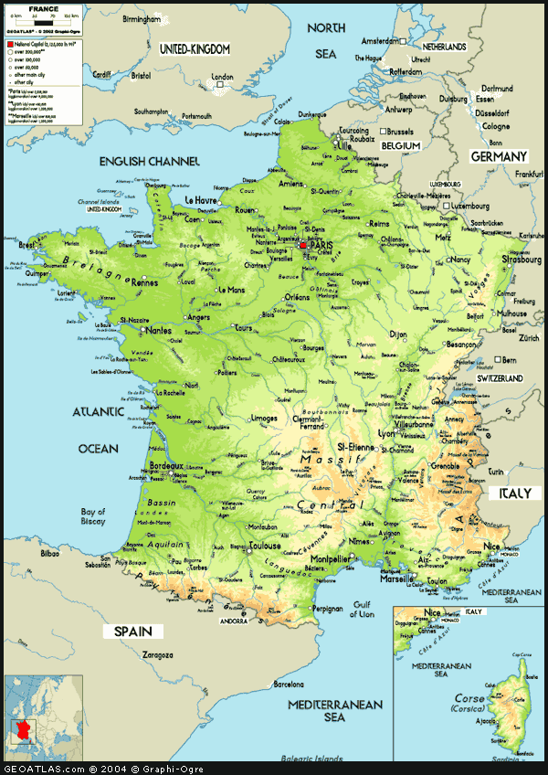
Sponsored Travel Sites:
France Travel Sites:
France

